Slide 1
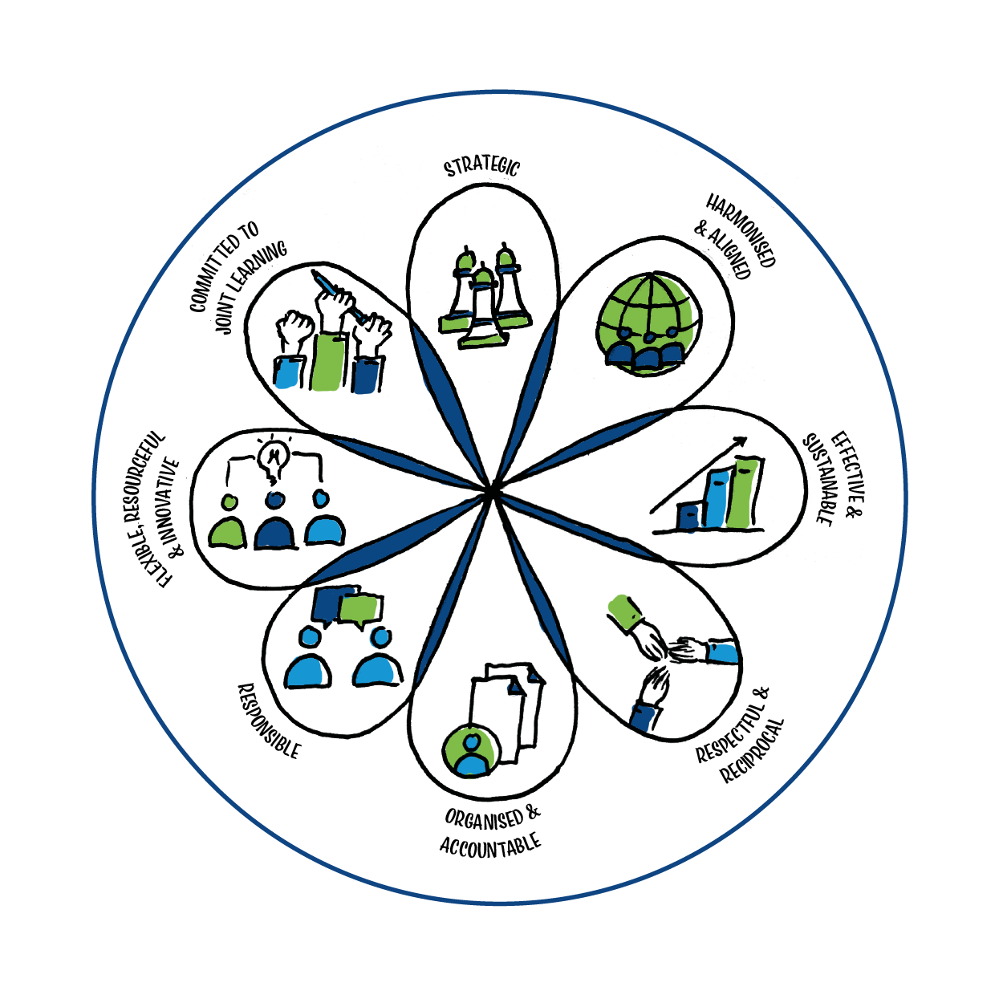





Power and partnerships
Exploring SDG17: Partnerships for the goals
Notes:
This PPT covers 3 themes and is largely aimed at those who are volunteering or establishing partnerships in the Global South. The material can be used flexibly. There are 3 x 2 hour sessions which can be used as they are or be adapted to build your own workshop depending on the focus you want to take. Timings have not been added and the facilitator will need to plan and decide how much time they want to spend on discussions.
The activities have been presented with instructions for delivery both virtually or in a face to face session.

Slide 2
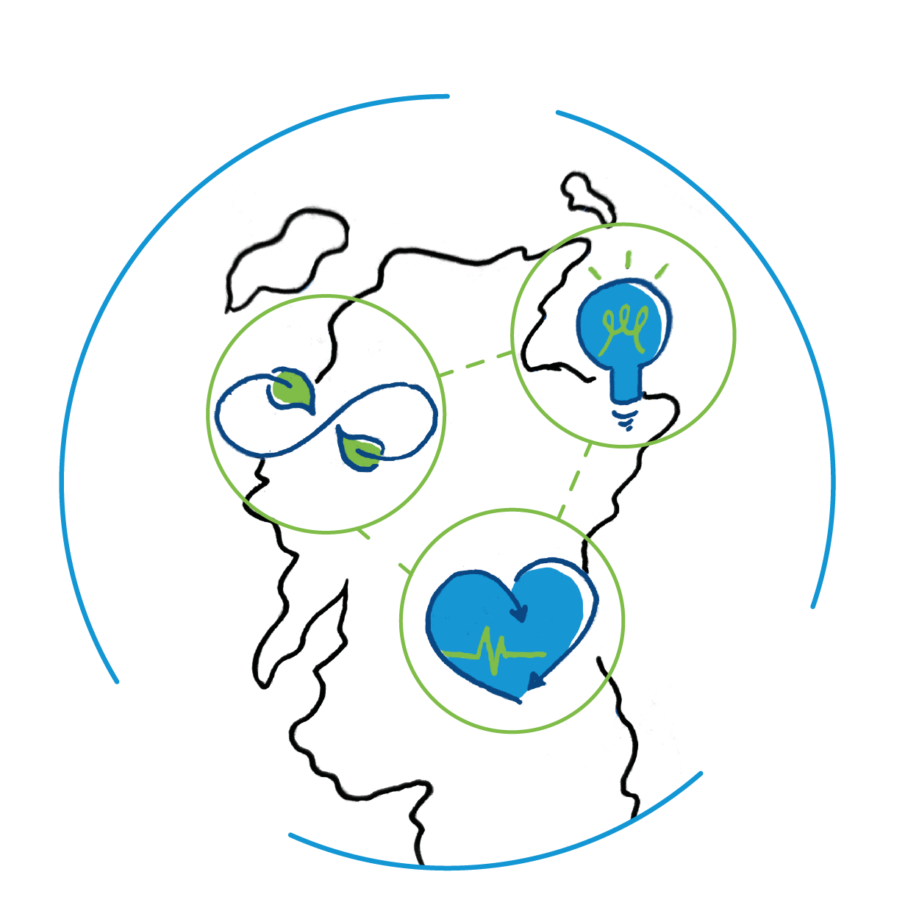
Part 1: Reflecting on power, identity and privilege
Activity 1: The social identity wheel
Activity 2: Invisible knapsacks: recognising our privilege
Activity 3: Power walk: how does power impact on my partnership?
Notes:
Part 1 is concerned with personal reflection and might be uncomfortable for some. It is recommended that the facilitator does some background reading on the issues raised (links included in the notes on slides) and considers how the activities will land with the participants.

Slide 3

Activity 1: The social identity wheel
Aims
To build understanding of our own social identities
To consider the various ways these identities become visible
To reflect on how those identities impact the ways others perceive or treat us
Notes:
The Social Identity Wheel is an activity that encourages participants to build their understanding of their own social identities and to reflect on the various ways those identities become visible or more keenly felt at different times, and how those identities impact the ways others perceive or treat us.

Slide 4
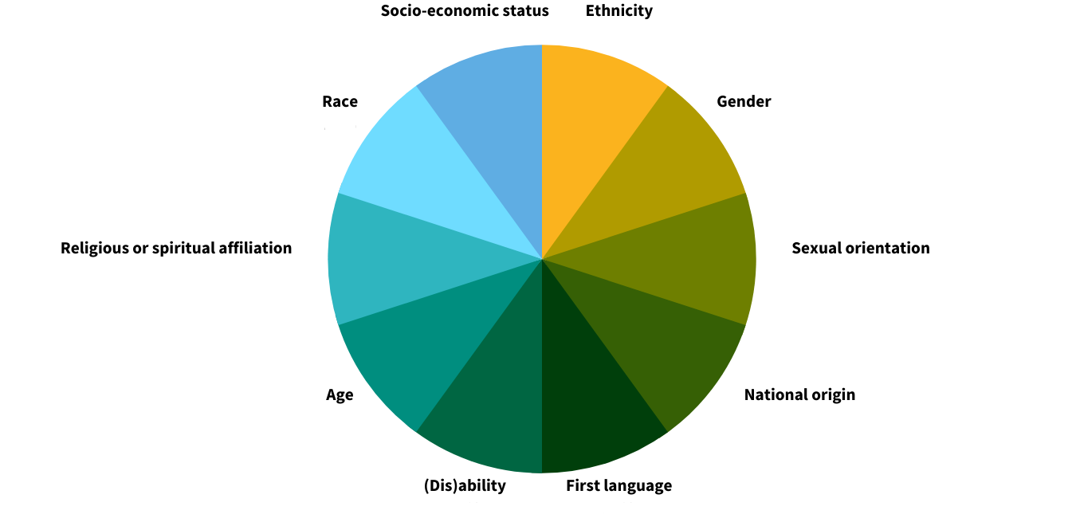
Activity 1: The social identity wheel
Notes:
This is a personal reflection activity. Participants should use the wheel to work through the self-reflection questions on the next page. If you would like a printed version of the wheel and questions you can find them here. https://sites.lsa.umich.edu/inclusive-teaching/social-identity-wheel/ You may wish to discuss and agree the categories you want to use at the beginning of the session. These are some suggested categories and there may be others which are important for the group and they want to include.

Slide 5
Activity 1: The social identity wheel
Self reflection questions
What identities do you think about most often?
What identities do you think about least often?
What identities would you like to learn more about?
What identities have the strongest effect on how you perceive yourself?
What identities have the greatest effect on how others perceive you?
Discussion question
Why is it important to critically reflect on our identities?
Notes:
Most of this activity is personal reflection using the questions on the slide. Use the final discussion question as a plenary for the whole group.

Slide 6

Activity 2: Invisible knapsacks – recognising our privilege
Aims
To understand various kinds of privilege, specifically White Privilege
To prompt participants to recognise and reflect on their own privilege and be able to identify how privilege influences daily life
To reflect on the larger impacts of privilege on daily life and overseas partnerships
Notes:
This follows on from the previous activity and allows participants to examine their own privilege (or lack of it) and to discuss how it impacts on them both personally and professionally. The activity is based on Peggy McIntosh’s “White Privilege: Unpacking the Invisible Knapsack”. A guide for facilitators on understanding privilege can be found here ttps://sites.lsa.umich.edu/inclusive-teaching/an-instructors-guide-to-understanding-privilege/ You can also find an excerpt from Peggy McIntosh’s book here – it is useful to share with participants as a good introduction to main activity. https://nationalseedproject.org/images/documents/Knapsack_plus_Notes-Peggy_McIntosh.pdf

Slide 7

Activity 2: Invisible knapsacks – recognising our privilege
Privilege
Societally granted, unearned advantages accorded to some people and not others. These systemic or structural advantages impact people based on identity factors such as race, gender, sex, religion, nationality, disability, sexuality, class, and body type.
Notes:
Introduce the concept of privilege using the above definition. Ask for comments / thoughts / reflections.
If using, give each participant a copy of the excerpt from White privilege: Unpacking the Invisible Knapsack https://nationalseedproject.org/images/documents/Knapsack_plus_Notes-Peggy_McIntosh.pdf and use this as a stimulus for a group discussion.
There are some discussion questions you can use on the next slide. If you are running this session online you will need to be able to make use of break out rooms and enable participants to choose a room to join.

Slide 8

Activity 2: Invisible knapsacks – recognising our privilege
Group discussion questions
What caught your attention or surprised you in this article?
Did anything on the list relate to your personal experiences?
Did anything in the excerpt raise questions for you?
What does McIntosh say is necessary to redesign social systems? What do you think of this?

Slide 9
Activity 2: Invisible knapsacks – recognising our privilege
Privilege list
Ability
Cisgender
Male (mostly cisgender)
Socio-economic status
UK citizenship
Notes:
McIntosh’s list is helpful for White people to imagine specific examples of oppression they don’t experience based on skin color. Inspired by McIntosh, other people have created similar lists of other types of privilege. On this slide there are some suggested categories. As a group you should decide if these are categories you want to work with or if there are some to add. As a facilitator it is important to ensure that ALL participants can identify with one category and recognize it as a privilege they have. Activity instruction are on the next slide.

Slide 10

Activity 2: Invisible knapsacks – recognising our privilege
Small group discussion questions
What is your initial reaction to this list?
Is there anything that surprises you, raises questions for you, or that you find problematic?
Can you share something on this list that you have experienced in your own life?
How do you think this privilege influences your experience at work
Notes:
Participants should review the five privilege list (slide 9) and think about which one they would like to focus on. In order to get the most out of this activity, you are strongly encouraged to choose the privileged identity that makes you the most uncomfortable and/or that you have had the least opportunity to think about. Participants create small groups based on a shared privilege they want to explore further.
They can then work through the small group discussion questions on this slide.

Slide 11

Activity 2: Invisible knapsacks – recognising our privilege
Whole group discussion questions
What did it feel like to read the list?
What is something you learned about yourself from the small group activity?
Did anyone discover areas of implicit bias?
Implicit bias: Describes the way that stereotypes and attitudes we are not aware of shape our behaviour; thoughts and feelings outside of conscious awareness and control.
Why is it important to be aware of privilege and how can we use our privilege to create positive change?
Notes:
You can use some or all of these questions to debrief the group. You may choose to look more deeply at what we mean by implicit or unconscious bias.
Thinking about privilege can bring up many unpleasant emotions such as guilt, anger, fear of making mistakes, sadness, and so on. It is important to exercise self-compassion and know that we all have privileges that we did not choose. However, because these privileges influence every aspect of life, we must also remind ourselves that unacknowledged privilege often prevents us from exercising important values such as equality, fairness, justice, and even kindness.

Slide 12

Activity 3: Power walk – how does power impact on my partnership?
Aims
To examine who holds power and privilege in a local and international partnership
To reflect on how to ensure equity in an international partnership
Notes:
This activity will explore how some of this power and privilege might look in a North / South global partnership. When entering into partnership overseas you will always hold some privileges and power, and when ensuring equity in partnership it is useful to have reflected on this, recognise it and consider how you present in this situation. It can also open up important issues of gender and sexuality and how these can impact on working relationships in countries with differing cultural norms and values from our own.

Slide 13
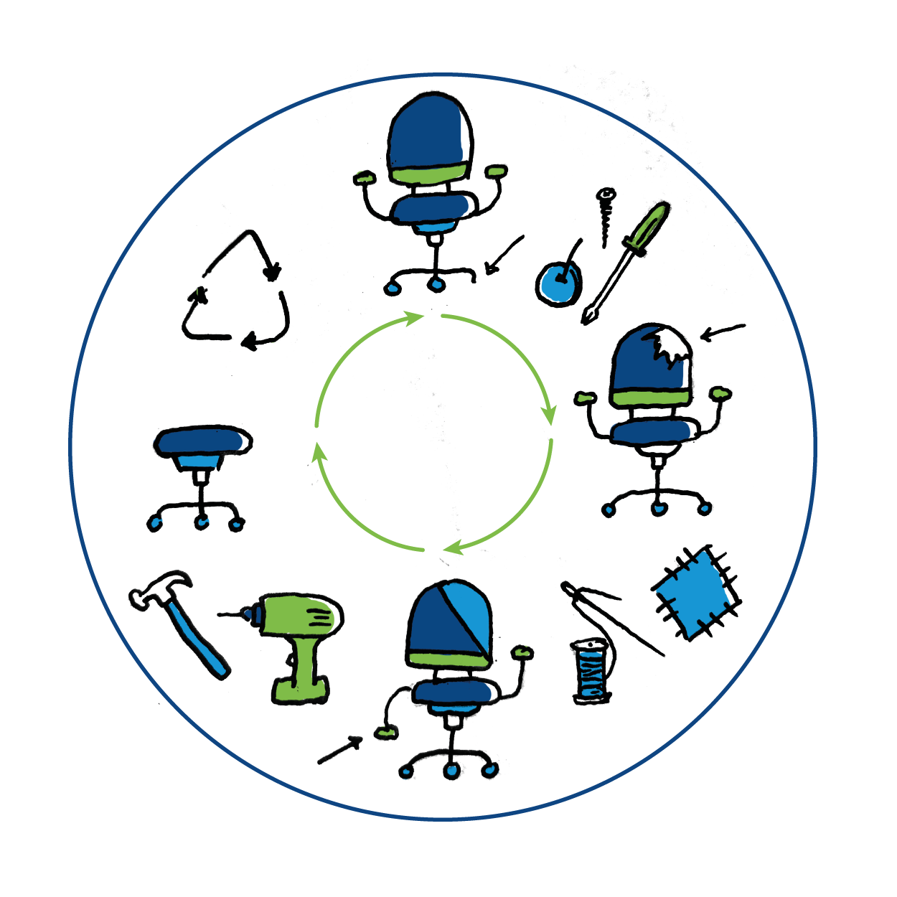
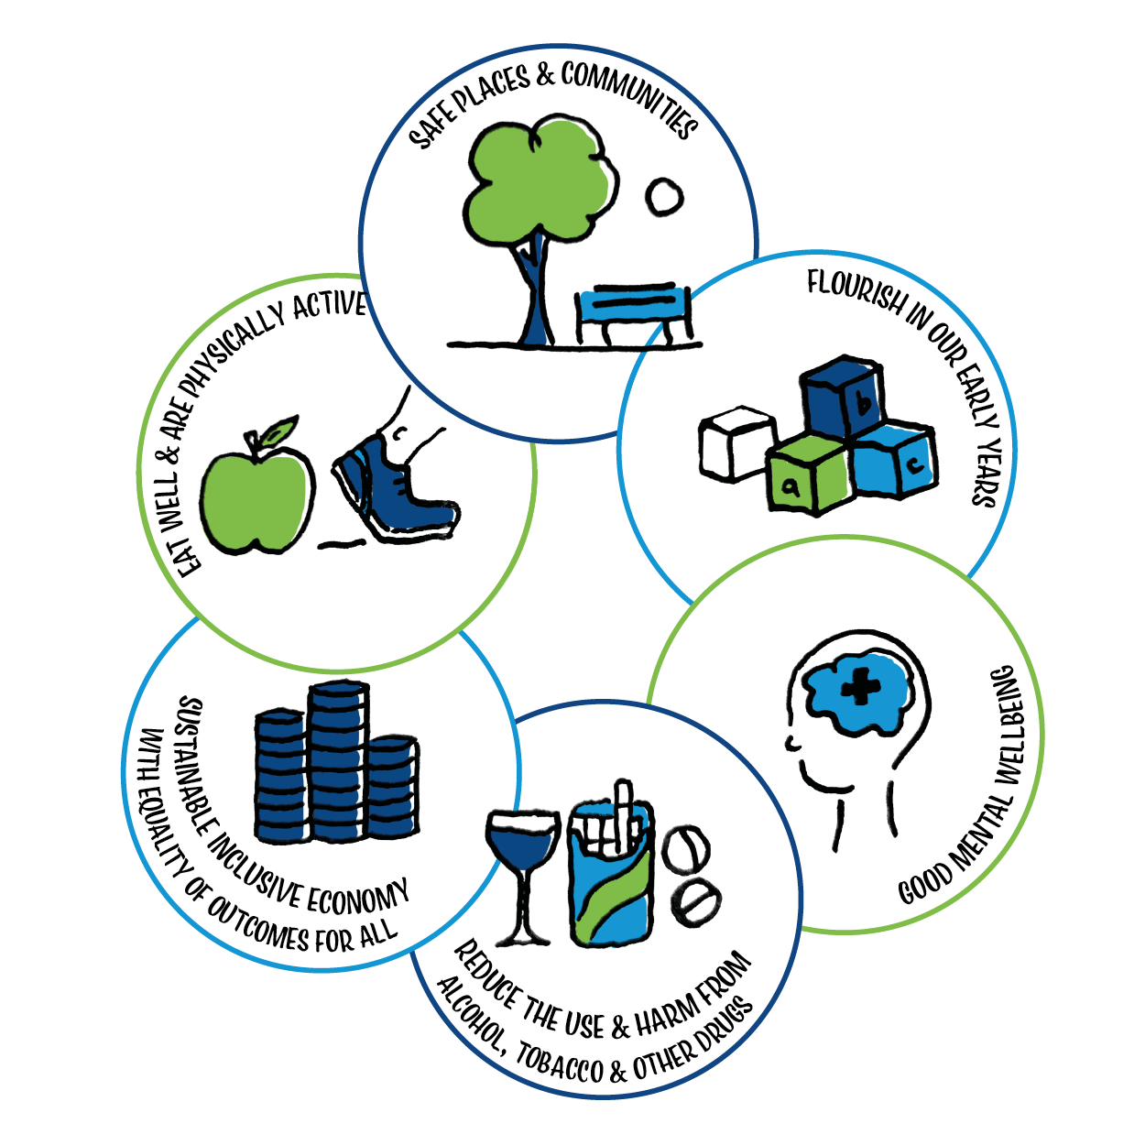
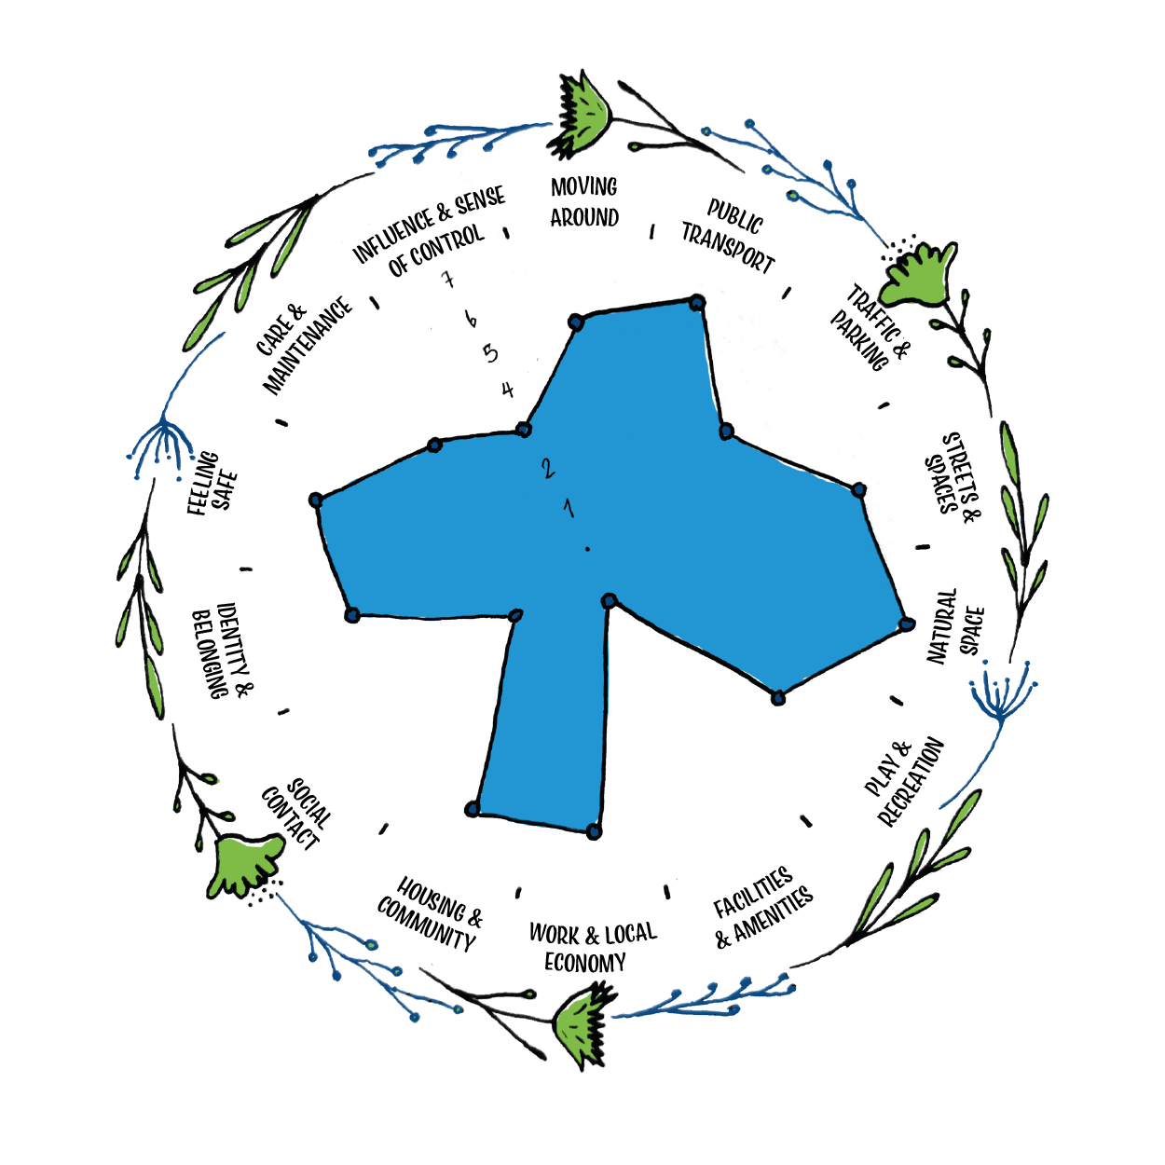
You are an Eastern European 35 year old male consultant oncologist working in a large hospital in Scotland. You want to establish a partnership in Zambia.
You are a 30 year old white female public health registrar and have volunteered overseas before starting university. You are keen to volunteer overseas again.
You are a 26 year old white non-binary nurse working in a rural community in the Scottish highlands. You are interested in volunteering but don’t know where to start.
You are a black 52 year old female consultant midwife in Lilongwe, Malawi. You are a fluent English speaker and keen to share practice and learning internationally.
Activity 3: Power walk – how does power impact on our partnership?
You are a 41 year old male porter of Asian heritage in a hospital in Glasgow. You have a peer life expectancy of 56.
You haven’t heard of health partnerships.
You are the 62 year old white male Director of a large health board in Scotland. You are a supporter of health partnerships and actively encourage staff to be involved.
You are a black, male 65 year old Minister of Health for Zambia living in the capital Lusaka. You are in favour of building overseas partnerships.
You are a white 34 year old female part-time administrator
in a busy hospital in the central belt.
You are a 44 year old female GP in Dundee. You are want to improve health inequalities within the community you work in.
A 22 year old black male health clinician working in a rural clinic in Kenya. You are keen to upskill and to learn.
Notes:
Stand participants in a line and give each a role to play as outlined in the slide – or invite participants to choose a character.
Explain that you will be calling out some categories like money, skills or gender that mean you have greater power and status. If they think their character has them, they must take a step forward or move to the front of the line. If they feel their character does not have it, then they must take a step back or move to the back of the line. The power categories are: Gender, Money, Community connections, Technology, Level of Authority, Language, Empowering Environment, Time for the project, Skill level , Personal attitude, Money, Ability to travel.
If you are doing this activity virtually – ask participants to award themselves 10 points every time they feel that their character can take advantage of that category.

Slide 14
Activity 3: Power walk – how does power impact on our partnership?
Discussion questions
How might each of these power categories impact on partnership?
Why is it important to consider these when embarking on a partnership with the Global South?
Power categories
Gender
Community connections
Technology
Level of authority
Language
Time for the project
Skill level
Money
Ability to travel
Notes:
Debrief with the participants. Did some characters travel further up the line or hold a large number of points at the end? Did some stay at the back of the line and were awarded 0 points? How did the participants feel about it? Follow up with a wider discussion on how the power categories impact on partnership using the discussion questions.

Slide 15
Part 2: Unlearning: charity, development and the media
Activity 1: Radi-Aid
Activity 2: What is development?
Activity 3: How to communicate the world
Notes:
Part 2 deals with how we understand the world and how it is represented in the media. It will ask questions around challenging our own assumptions and stereotypes as well as providing ideas for how to present and share experiences of volunteering or partnership with the Global South with dignity and solidarity.

Slide 16

Activity 1: Radi-Aid
Aims
To challenge perceptions around issues of poverty and development
To reflect on the difference between charity vs justice
Notes:
The Radi-Aid film and the Rusty Radiator Awards were created to challenge the perceptions around issues of poverty and development – to change the way fundraising campaigns communicate, to break down dominating stereotypes and to open up the conversation beyond charity. Moving from pity and distance from the problem (guilt) to a sense of connection and ability to make a difference (positive action).

Slide 17

Activity 1: Radi-Aid
Source: https://www.youtube.com/watch?v=oJLqyuxm96k
Notes:
Watch the video clip ( 4 minutes) and discuss the questions on the next slide.

Slide 18
Activity 1: Radi-Aid
Discussion questions
How did the film make you feel?
Why do you think the film was made?
What stereotypes were challenged?
Is charity always a good thing?
What is the difference between charity and justice?
How do you understand the term ‘white saviour’?
What implications does this have for you as a volunteer overseas?
Notes:
Visit the Radi-Aid website for more short films.

Slide 19

Activity 2: What is development?
To explore different notions around what is ‘development’
To reflect on how our understanding of development impacts on our partnerships and relationships in the Global South
Notes:
The term ‘Development’ has become increasingly controversial. In this activity we question what it is, who does it and how it impacts on people’s lives.

Slide 20

Activity 2: What is development?
Which of these ideas (if any) are most closely associated with your understanding of development?
Abundance of material wealth
Availability of technology
High levels of literacy
Access to health care
Do you think your country is ‘developed’?
What are your parameters for evaluating development?
Where do those parameters come from?
Notes:
Adapted from Learning to read the world from others eyes – Vanessa Andreotti https://developmenteducation.ie/resource/learning-to-read-the-world-through-other-eyes/
You can also share this useful piece on the language used by the international development sector in Scotland from SIDA https://www.intdevalliance.scot/news/decolonising-our-language-and-bringing-public-us

Slide 21

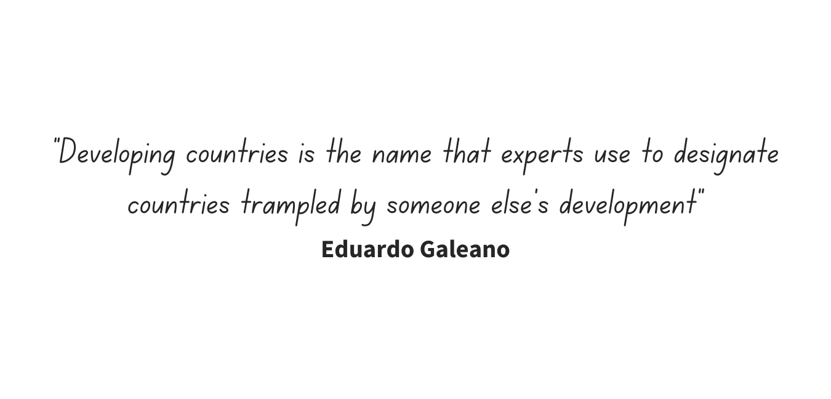
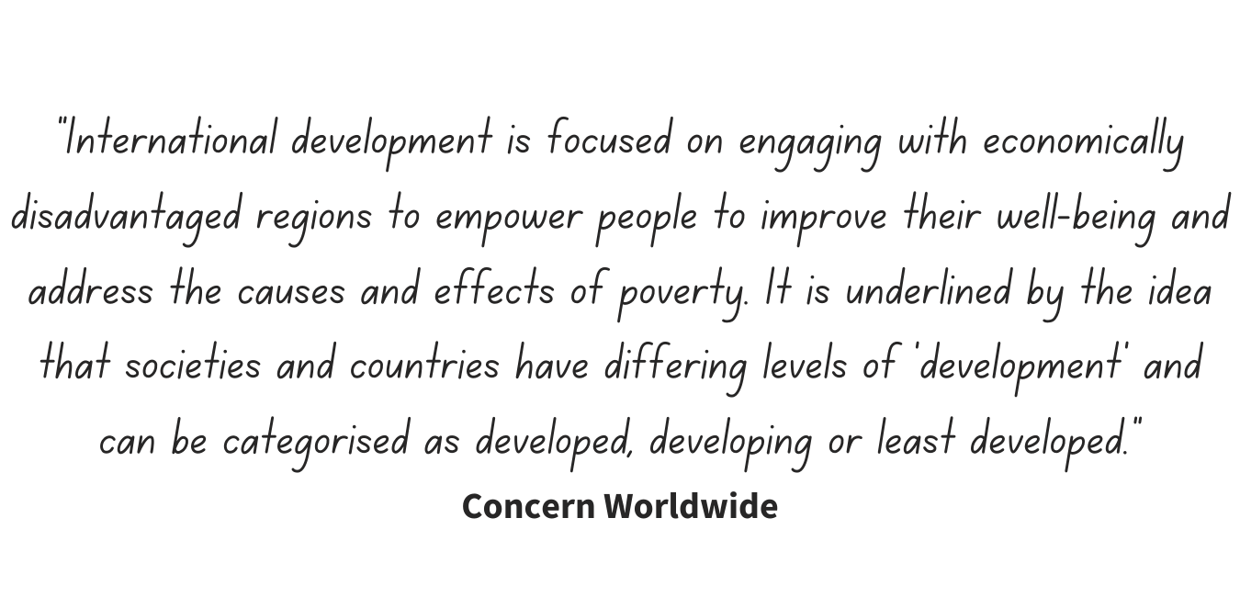
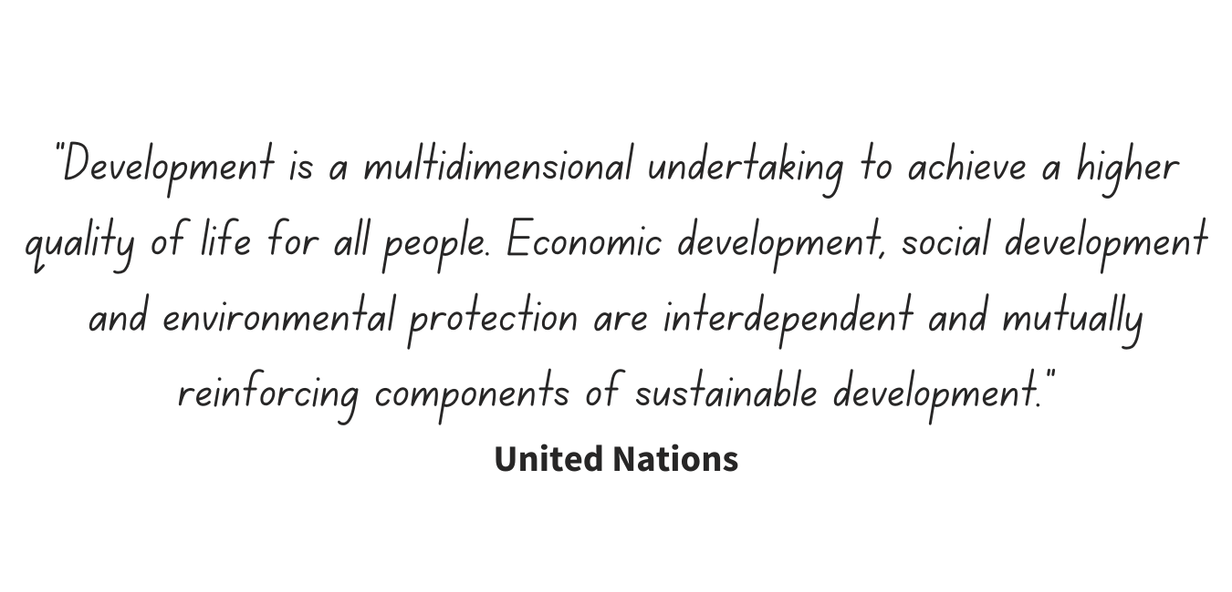
Activity 2: What is development
Notes:
Read the following statements and cartoon over the next 3 slides. Ask participants to select a quote or cartoon which they find the most useful in terms of challenging or reinforcing their ideas around international development. Use the discussion questions on the slide 24 to reflect on how the group understands the term ‘development’.

Slide 22
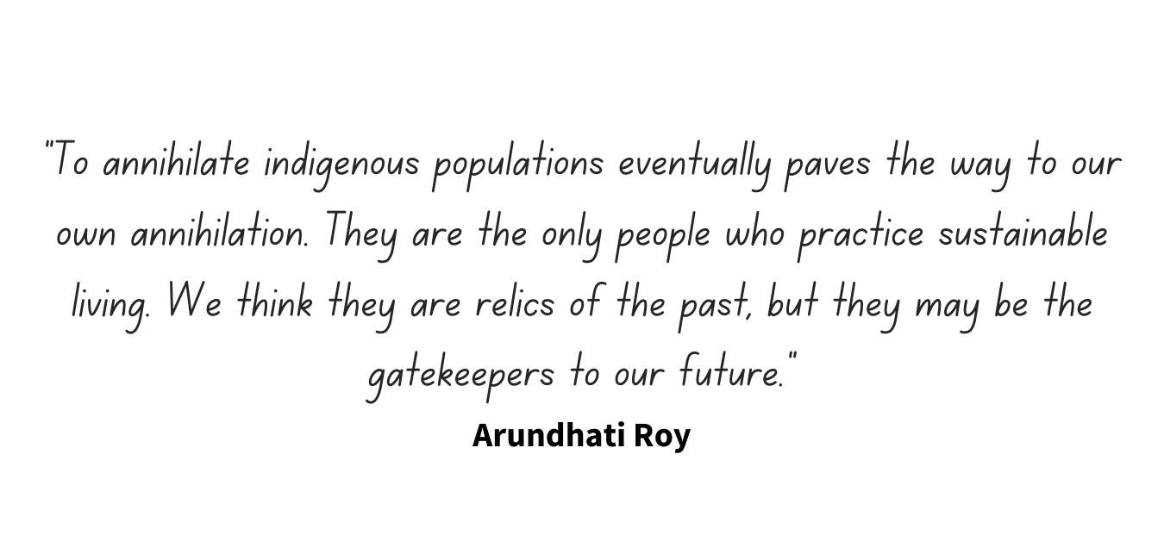
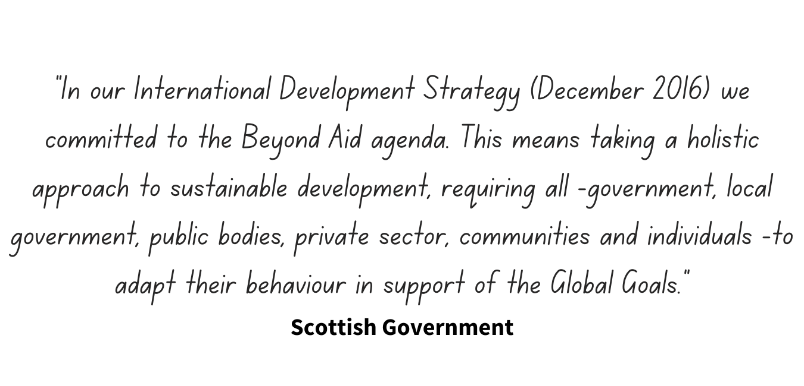
Activity 2: What is development

Slide 23
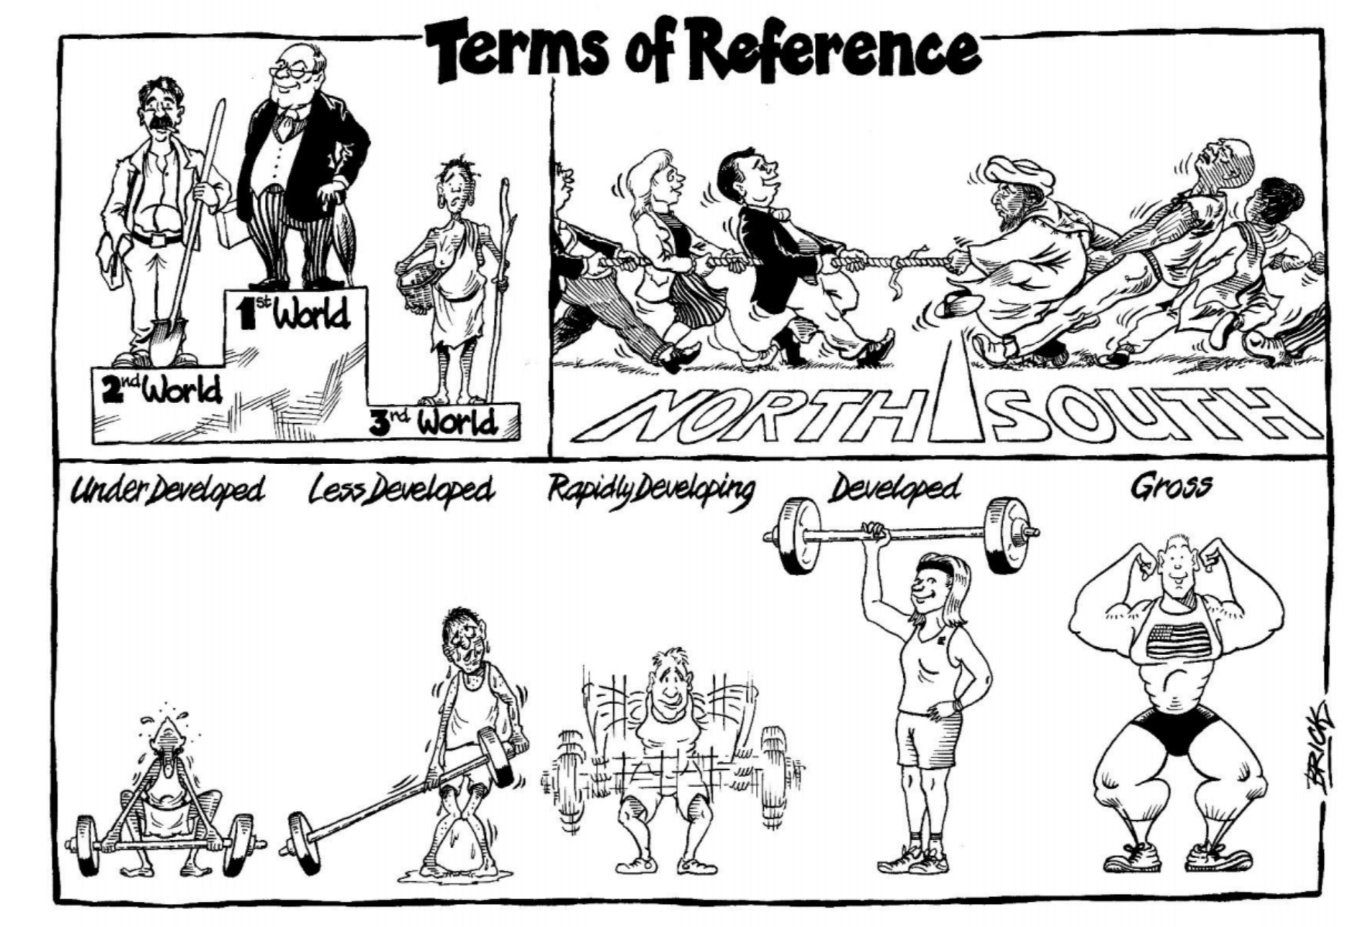
Activity 2: What is development
Credit: Cartoon by Brick www.brickbats.co.uk
Notes:
cartoon by Brick www.brickbats.co.uk

Slide 24
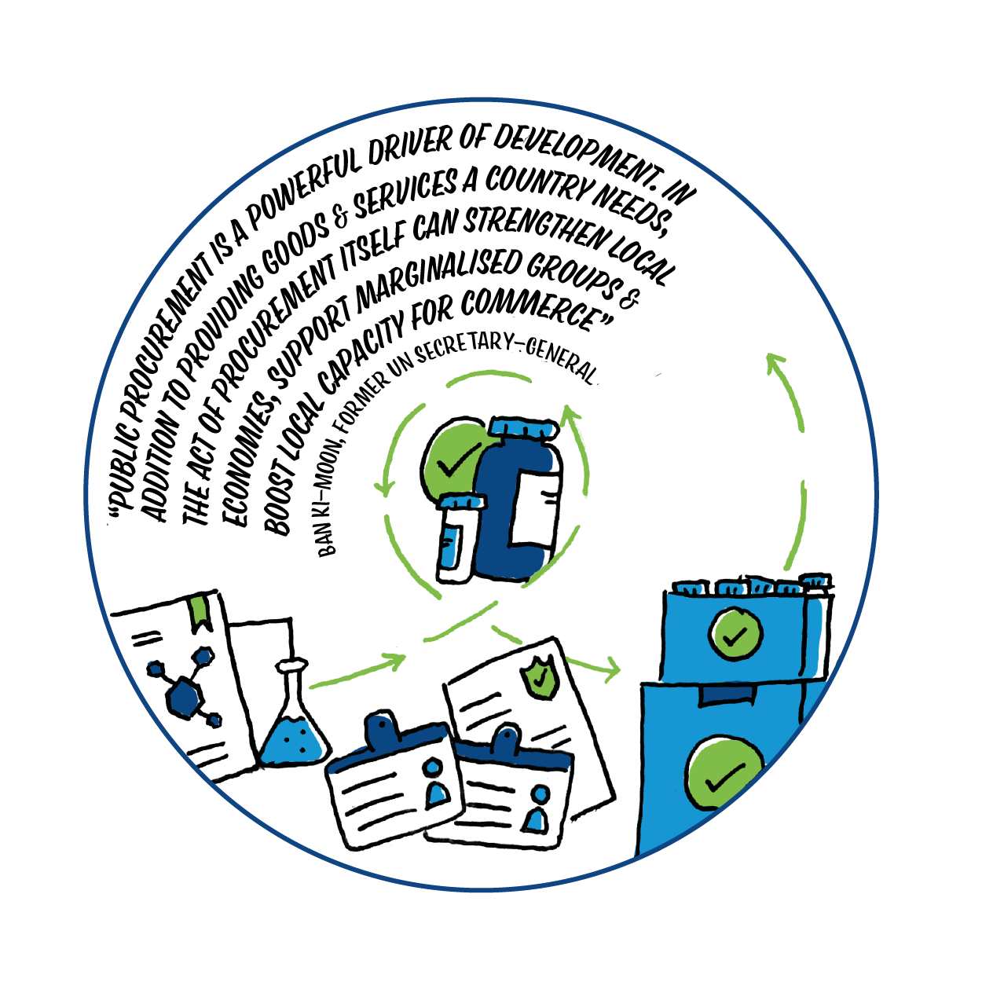
Activity 2: What is development?
How is development defined in these different statements?
What do you think are some of the assumptions informing these perspectives?
What could be the implications of these assumptions?
How do you understand the term ‘international development’? Is it a term we should still be using?
Notes:
There are many different understandings of what is international development. Each year the UNDP publishes its Human Development Report which includes a measure of human development known as the Human Development Index (HDI). The HDI measures the three key areas – health (life expectancy in years), knowledge (literacy rates) and resources (purchasing power parity or GNI adjusted by relating it to purchasing power, e.g., taking taxes into account, etc.). It is important that ‘expert’ voices in development are diverse and include academics and commentators from the Global South who emphasise the structural and historical reasons for underdevelopment.

Slide 25

Activity 3: How to communicate the world
Aims
To explore how images of the Global South are used in the media
To create a set of guiding principles to use when sharing images from the Global South within the NHS and in case studies
Notes:
If we are sharing images and stories from the Global South we have a duty to ensure we are doing so in a way which ensures dignity and promotes solidarity.

Slide 26

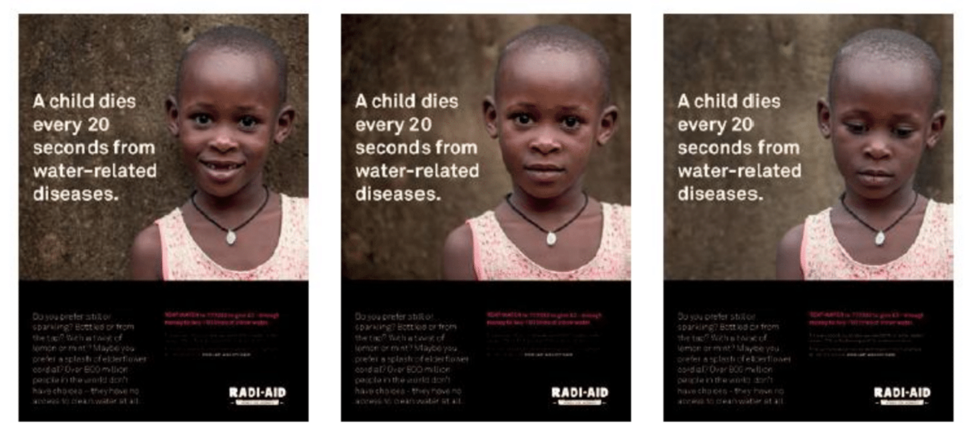
Activity 3: How to communicate the world
Which image do you prefer? Why?
Watch one of these film clips from Dochas or RadiAid
Notes:
Using the images and selected film clips, brainstorm in the chat box or on flip chart paper, things to think about when taking and using images to share your experiences from overseas volunteering.
You can read the full report from RadiAid here https://www.radiaid.com/which-image-do-you-prefer

Slide 27

Activity 3: How to communicate the world
Questions to consider when using images of people
Do the people in the images show diversity of the population?
How can you better show that the local community have the capacity to help improve the situation?
What is the context and how is it communicated? Who are the people in the photos and how do they relate to the situation?
Are the people in the images portrayed with dignity?
Does the picture show the problem or the solution to the problem?
Notes:
If you are sharing images and creating case studies these are a useful set of reflection questions to use.
You can use the case studies LINK TO NHS CASE STUDIES and use the questions to consider how the images have been used.
Alternatively you can select some images from current overseas fund raising campaigns and interrogate them using the above questions.
A further question would be to consider how the text and image work together.

Slide 28


Activity 3: How to communicate the world
Principle 1: Promote dignity
Principle 2: Gain informed consent
Principle 3: Question your intentions
Principle 4: Challenge stereotypes!
Notes:
Finish the activity by returning to your original brainstorm – jamboard or flip chart paper – are there any other ideas you would like to add to them.
Further reading on this can be found here https://www.dochas.ie/assets/Files/Illustrative_Guide_to_the_Dochas_Code_of_Conduct_on_Images_and_Messages.pdf

Slide 29
Part 3: Creating and sustaining equitable north/south partnerships
Activity 1: Hot air balloons
Activity 2: Moving towards equity
Activity 3: Principles of partnership
Activity 4: Case studies
Notes:
Part 3 is for those who are involved in a partnership with the Global South or who are planning one. It provides activities to reflect on where you are on the journey and what you need to do to sustain an equitable partnership. It invites you to use various tools to support this process. Ideally you could run some of these activities with your overseas partners to help facilitate better understanding and co-operation.

Slide 30


Activity 1: Hot air balloons
Aims
To consider what is required to make your partnerships take off
To reflect on what is preventing or hindering you partnership from progressing
Notes:
A partnership is like a hot air balloon. Things that are helping the partnership get off the ground are in the balloon basket – the people, their vision, attitudes and practice. The things that are preventing the hot-air balloon from flying far are in the weights around the basket. These fall to the ground as the balloonists take charge and pilot the hot-air balloon on its journey.

Slide 31

Activity 1: Hot air balloons
Draw a hot air balloon label it in the following way
Put the things which help your partnership in and around the basket
Put the things which are hindering your partnership in the weights tied to the basket
Put your aspiration for your partnership into the sky
Notes:
Either put participants into break out rooms with a whiteboard / jamboard or if running f2f give them flip chart paper and pens. Ask them to draw a hot air balloon. They can follow the instruction on the slide. As a whole group share your balloons and discuss ideas for mitigating issues hindering partnership and ideas for achieving aspirations.

Slide 32

Activity 2: Moving towards equity
Aims
To explore some of the issues which can prevent equity in a partnership
To identify possible solutions to overcome or to mitigate these issues
Notes:
This activity connects to Section 1, activity 3. If you are putting together a session plan with a particular focus on equity in partnership it would be useful to include both activities.

Slide 33

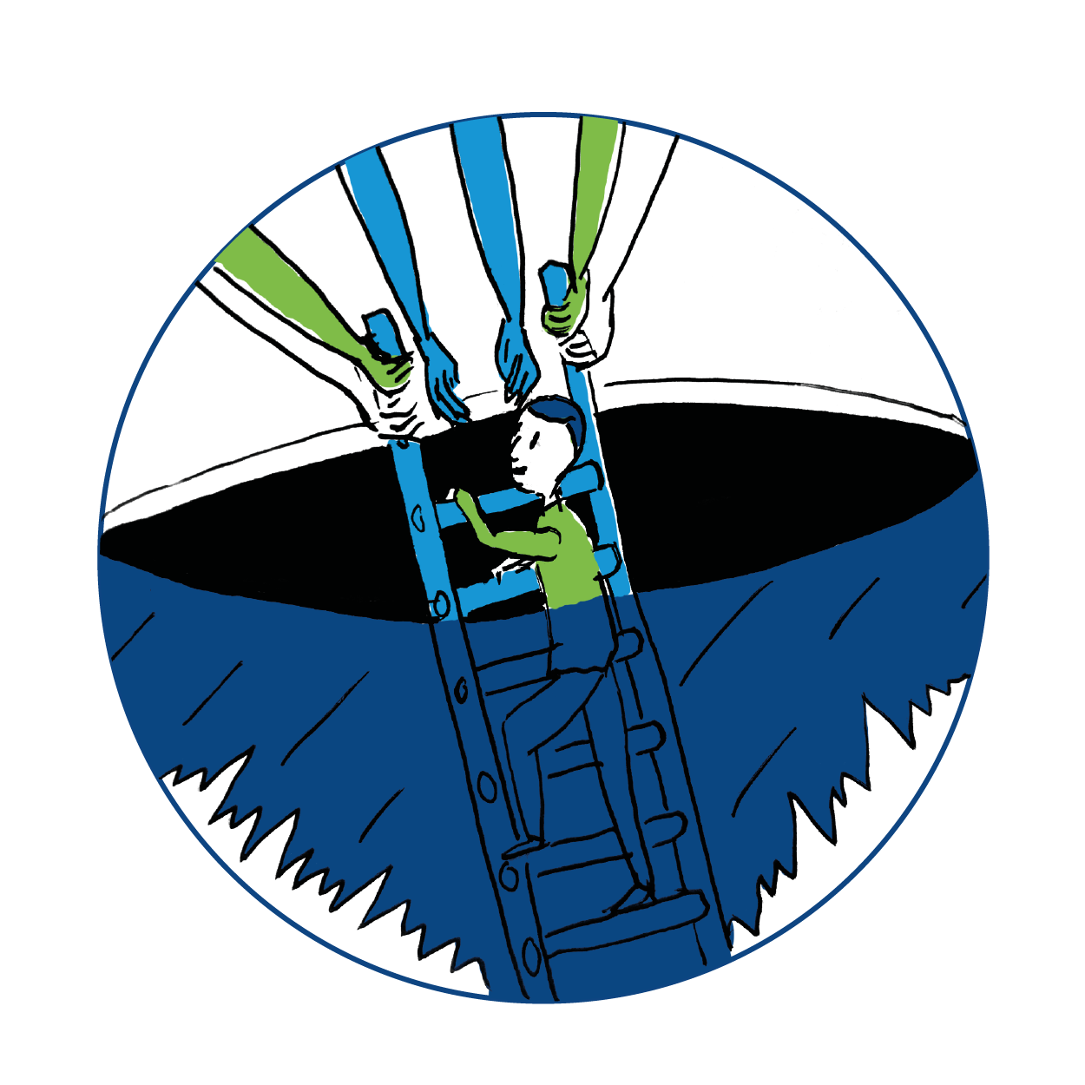
Activity 2: Moving towards equity
Language
Does the language used for communication exclude anyone? Is there an awareness of different English language usage, colloquialisms, acronyms etc?
Authority
How are decisions made in your partnership? Have you looked at power inequalities and how they were constructed historically?
Resources
Is access to technology and other resources equitable in the partnership? If not, does it cause problems and can they be resolved?
Money
Who is responsible for managing the finances of the partnership work? Does it create a power imbalance? How can you address this issue?
Time and capacity
What are the expectations and realities of time / capacity within the project? Are they recognised and equally valued?
Skills
What expertise does each partner bring? Are they equally valued?
Intercultural issues
Attitudes, norms and laws towards gender, sexual orientation, religion and more will vary.
How do these impact on your partnership?
How might you address cultural norms which clash with your own values and beliefs?
Notes:
If running this F2F, participants can work in groups on flipchart paper and carousel around the 7 themes – or select the ones you think are most useful for the group to explore. They should respond to the challenge using the reflection questions and adding their own personal experiences too depending on the group. The aim is to discuss ways around some of these possible barriers to equitable partnerships.
If running online, divide the group into break out rooms and give each group 1 or 2 of the issues to discuss. Ask each virtual group to nominate a spokesperson to share the groups ideas.
Debrief by creating a flipchart list of ideas and principles that must be addressed in order to sustain equitable partnerships.

Slide 34

Activity 3: The principles of partnership
Aims
To become familiar with the THET principles of partnership
To identify useful tools to use to ensure equitable and reciprocal partnerships with the Global South
Notes:
This activity encourages participants to engage with the THET principles of partnership.

Slide 35
Activity 3: The principles of partnership
Notes:
Introduce the THET principles of partnership – this link has more details to share with the participants. https://www.thet.org/principles-of-partnership/
Ask participants to work in small groups – either f2f or in break out rooms – and identify their top 3 most important principles for beginning a partnership or sustaining an established partnership depending on the experience in the room.
Share the feedback between groups and highlight the THET resources which are available to support partnerships overseas.

Slide 36



Activity 3: The principles of partnership
Click to watch
Source: Principles for Partnership seminar
Notes:
The Scotland Malawi Partnership (SMP) has also developed a set of principles for partnership in collaboration with colleagues in Malawi. Watch this 10.33 minute video clip of David Hope-Jones, CEO of SMP, as he introduces and explains the SMP principles for partnership. You can find out more about the principles and how to use them as a reflective framework on their website https://www.scotland-malawipartnership.org/about-us/our-partnership-principles

Slide 37
Activity 3: The principles of partnership
When talking about partnership principles remember to think about:
The power relationships and cultural norms
The words you are using
How you are communicating
Who you are communicating with
Notes:
Hold a plenary discussion around the tools introduced, how and when you might use them and what the important take aways are for the group.

Slide 38



Click to watch via YouTube NHS partnerships case study with Stuart Watson
Click to watch via YouTube NHS partnerships case study with Rhona MacDonald
Notes:
Share the case studies:
Rhona: https://youtu.be/IE_c_dXiMyw
Stuart: https://youtu.be/c1NpEB9je7A

Slide 39


Thank you for your time
www.scotdec.org.uk
www.scottishglobalhealth.org
@scotdeclearning
@scottishGHCU
The contents of this document are the sole responsibility of the 15 project partners and can in no way be taken to reflect the views of the European Union.

