Slide 1






Imagining better futures:
Global Citizenship within NHS Scotland
Taking action for a just and sustainable world
Notes:
This session is an introductory session and is closely connected to the activities in the NHS SDG booklet and flash cards. Many of the activities have more detailed reflections and instructions in the book and would be enhanced by using the flash cards too. We recommend that you use them together. You can find the materials here: https://www.scottishglobalhealth.org/resources/

Slide 2
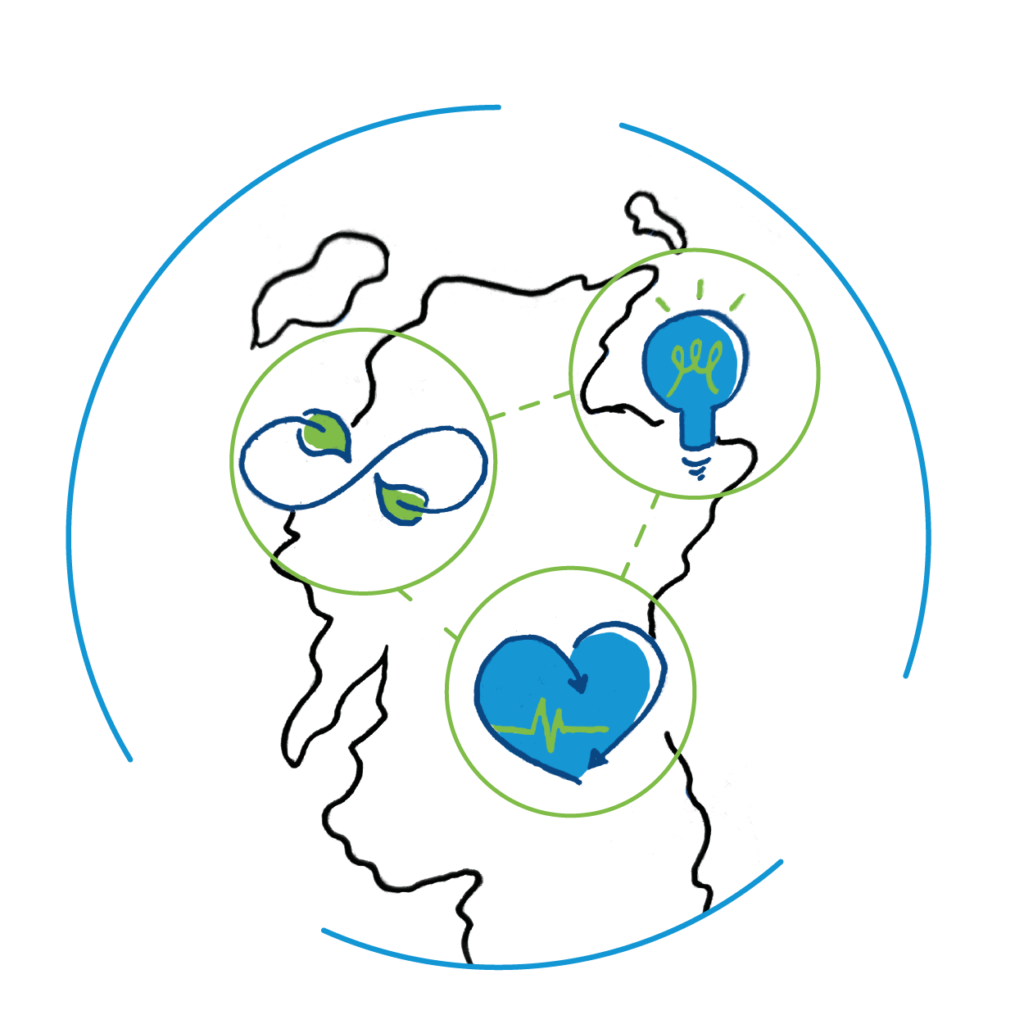
Global Citizenship and me
What does Global Citizenship mean to me?
Notes:
This is a good way of seeing what people’s perspectives are in the room.
Method 1: Ask everyone to come up with 3 words which best describe what Global Citizenship means to them and keep a note of them. Revisit at the end. Do they want to change the words? At the end of the session check out by asking each participant to share one word which sums up the most important aspect of Global Citizenship for them.
Method 2: Use a menti meter to collect the words at the beginning and then again at the end if appropriate – reflect on how participants ideas have shifted during the session.

Slide 3

What is Global Citizenship?
Global citizenship is a way of living that recognises our world as an increasingly complex web of connections and interdependencies.
One in which our choices and actions may have repercussions for people and the communities both locally, nationally and internationally.
This approach nurtures personal respect and respect for others where ever they live. It encourages individuals to think deeply and critically about what is equitable and just, and what will minimise harm to our planet.
Notes:
This is a brief description of what is Global Citizenship taken from The International Development Education Association of Scotland http://www.ideas-forum.org.uk/ For further ideas on Global Citizenship Education visit the Bride 47 website https://www.bridge47.org/global-citizenship

Slide 4



What is a Global Citizen?
Thoughts
Feelings
Actions
Notes:
You might want to take time as a group to think about some of the key traits of a global citizen. You can frame it around knowledge / skills / values using the slide.

Slide 5

Global Citizenship competencies
Skills
Attitudes and values
Critical and creative thinking
Empathy
Self awareness and reflection
Communication
Co-operation and conflict resolution
Ability to manage complexity and uncertainty
Informed and reflective action
Sense of identity and self-esteem
Commitment to social justice and equity
Respect for people and human rights
Value for diversity
Concern for the environment and commitment
to sustainable development
Commitment to participation and inclusion
Belief that people can bring about change
Notes:
This is a list of GC competencies developed for education by Oxfam. They can be a useful reflection tool after you have considered your own ideas on key traits or competencies for Global Citizenship.
Consider how these skills and values are realised or developed in your personal or professional life.

Slide 6

The Sustainable Development Goals
In September 2015 world leaders committed to the Global Goals for Sustainable Development.
17 goals to achieve 3 extraordinary things in 15 years:
End extreme poverty
Fight inequality and injustice
Combat climate change
Notes:
The 2030 Agenda for Sustainable Development is a plan of action for people, planet and prosperity. Signed in 2015 by the member states of the United Nations, it is an urgent call demonstrating the
action needed to shift the world onto a more sustainable path. The 17 Sustainable Development Goals (SDGs) and 169 targets demonstrate the scale and ambition of the agenda.
The SDGs apply to every country in the world including Scotland and are the responsibility of governments, businesses, civil society and citizens to deliver. The goals are designed to be interdependent and no one goal is more important than another. The success or failure to meet one target impacts on the success and failure of the others. The goals are also designed to be inclusive with a pledge to ‘leave no one behind.’

Slide 7

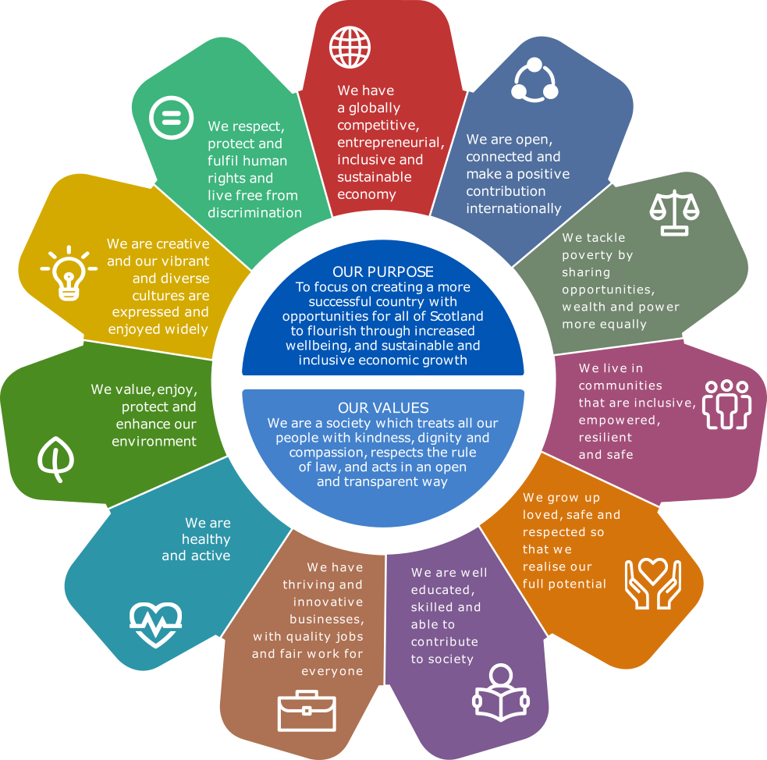
National Performance Framework
Notes:
The National Performance Framework (NPF) is Scotland’s way to localise the SDGs. The NPF measures progress on a national level against 11 National Outcomes to which relevant SDGs are mapped.
Each National Outcome has associated indicators which are tracked and publicly reported on. The NPF has wellbeing, sustainability and inclusivity as core aims.
In Scotland there is an open coalition, the SDG Network Scotland, that any individual or organisation can join, where the SDGs are championed and delivered by all, bringing together the voices
of over 500 people and organisations across Scotland.

Slide 8

Notes:
These are the 17 SDGs. You can use the flash cards to explore each goal individually or to think about which goals are most relevant to your own context. Participants might want to consider which goals are most relevant to the NHS or reflect on the impact to the NHS if a particular goal was achieved. See the booklet for further ideas on ways to explore the goals. https://www.scottishglobalhealth.org/resources/

Slide 9
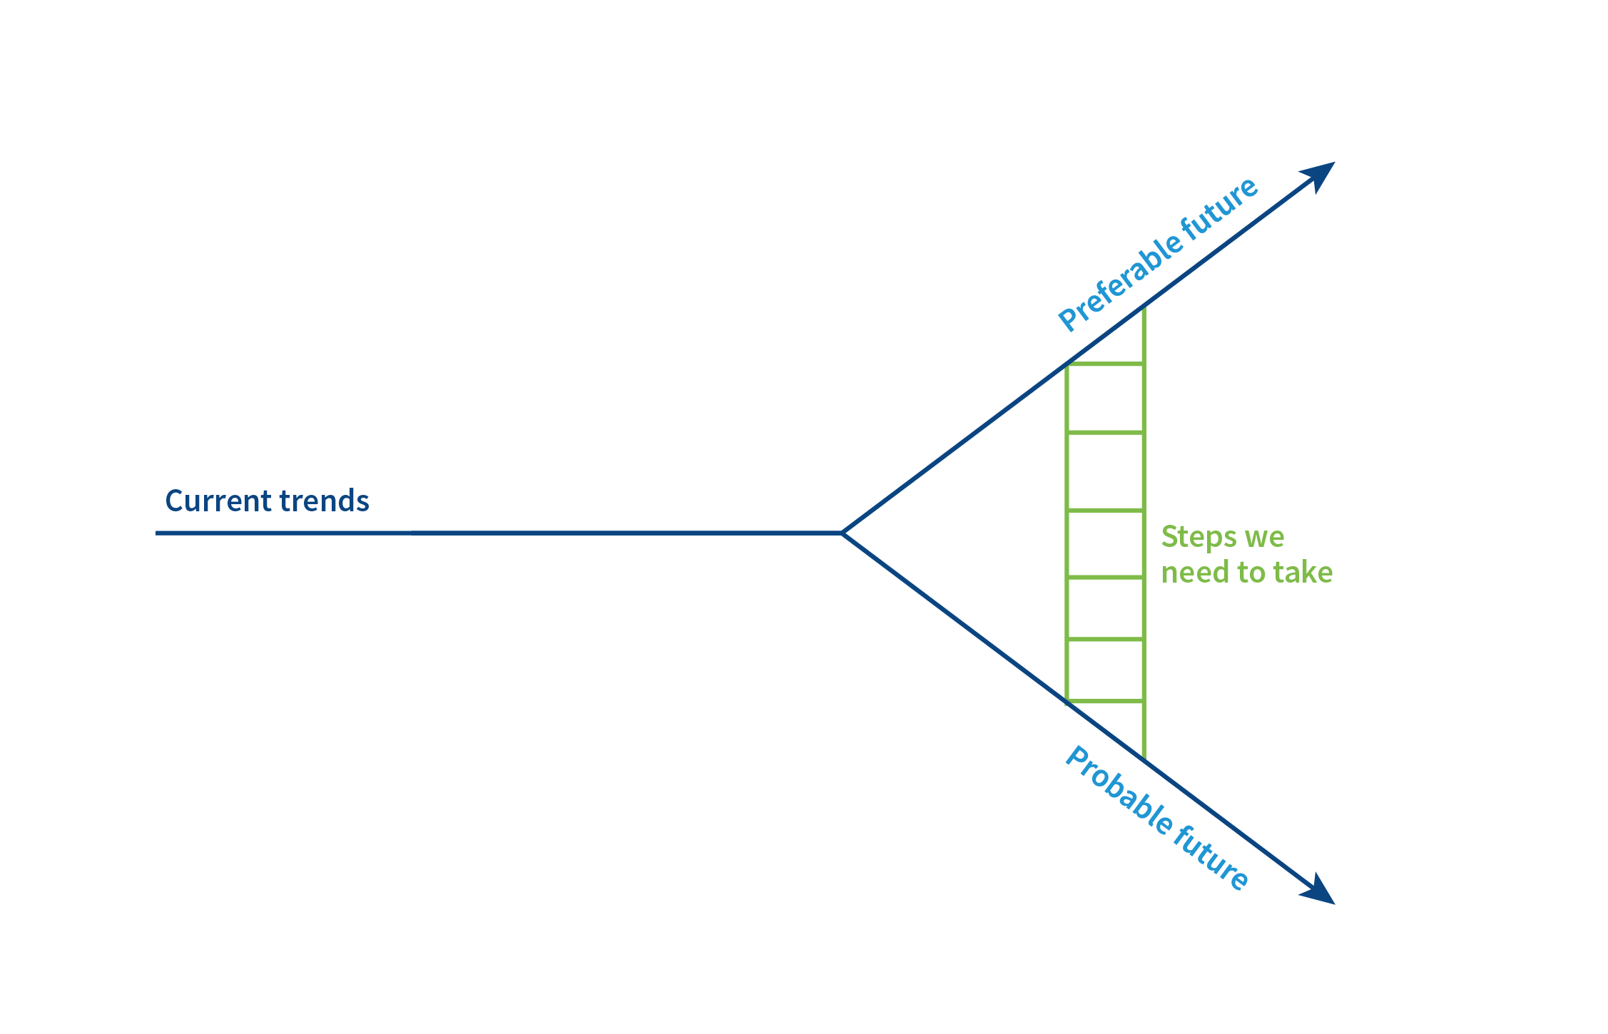
What future do I want?
Notes:
This activity is design to help you imagine a better future and start thinking about practical steps you can take to bring about change. If you have already explored one of the SDGs you might want to use that or choose another issue that you are interested in. This activity can be carried out on a jamboard if delivering online, or in small groups using flipchart paper if face to face.
Method: ask participants to note down the current situation or trends relating to this SDG or issue. Record your findings on the diagram. As a group identify factors that are likely in a ‘probable future’ if no action is taken – think about what the situation might be like for both people and planet? How far away in the future is this?
How will NHS Scotland be affected? Record your findings on the diagram.
Repeat the process but for the ‘preferable future’.
As a group, identify steps needed to move from the probable future to the preferable future and note them on the ladder.
More detailed reflections are included in the booklet. https://www.scottishglobalhealth.org/resources/

Slide 10
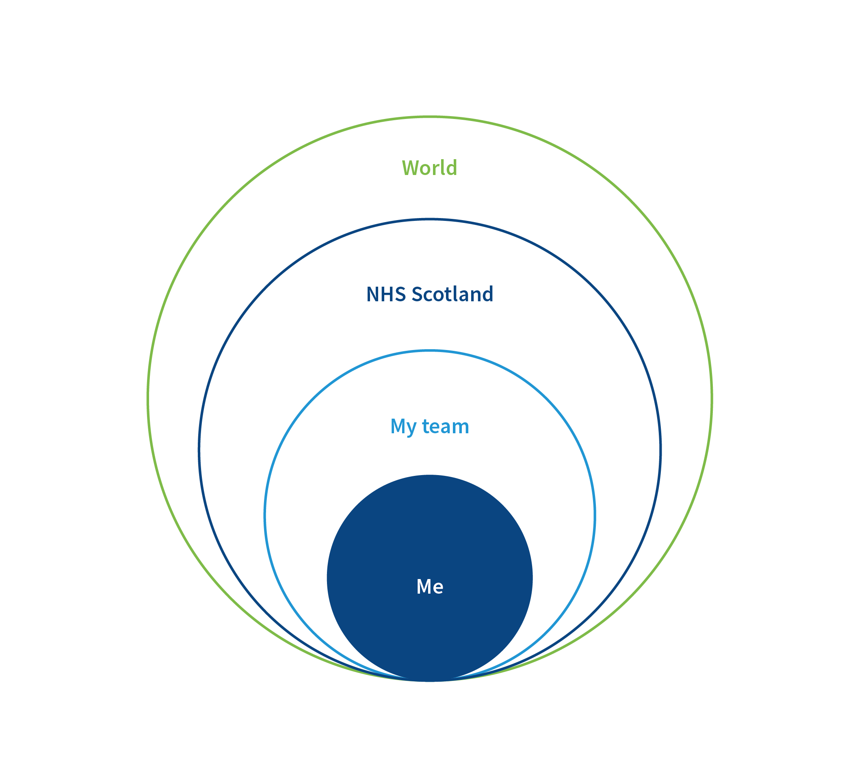
Influencing change
Notes:
Now we encourage you and your group to think a bit deeper about the actions identified through the previous activity. What role can you play in influencing the change you want to see?
Method: Online this can be a group discussion in break out rooms. In a face to face session groups can draw the diagram as shown on the slide and start to fill in the sphere of influence. (There is a more detailed outline of the this activity in the booklet ) The reflection questions below can be used to debrief and share learning across the group or used in individual groups to guide them through the activity.
What actions could you take as an individual to contribute towards making your desired change?
· Who would you need to influence or work with to take these actions?
· Think about making the change at wider levels, as shown in the diagram. How could you influence change as a team?
What about at an organisational level? What barriers might you face?

Slide 11
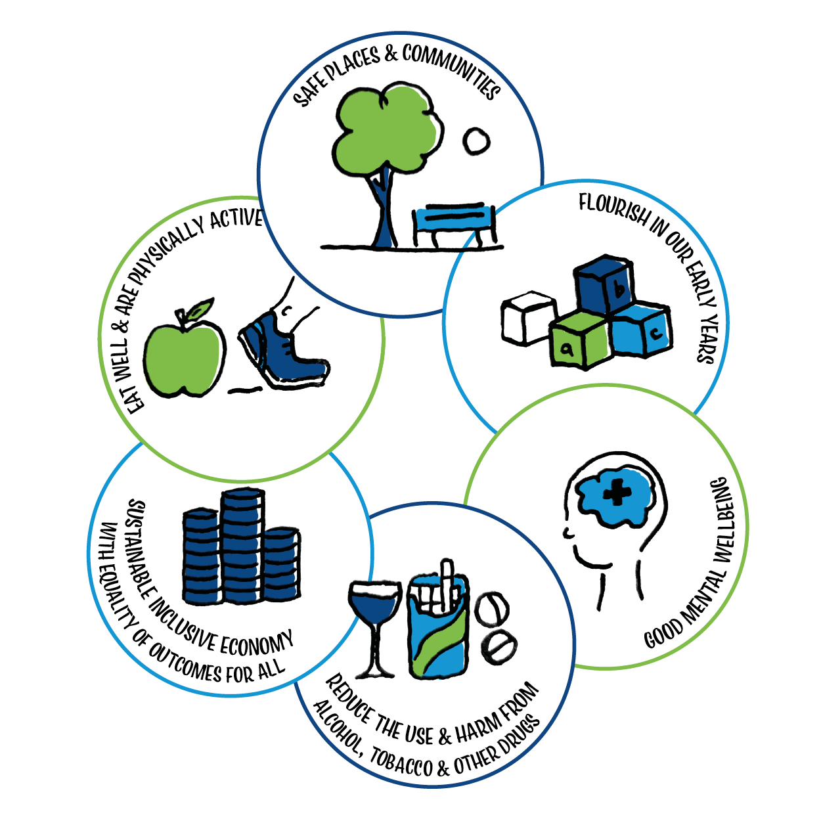

Exploring values
NHS values
Care and compassion
Dignity and respect
Openness, honesty and responsibility
Quality and teamwork
Notes:
Values are connected to our desire for change. A large body of evidence shows that values are of central importance in leading people to express concern about social and environmental issues – whether this concern is expressed by changing aspects of day-to-day behaviour, by becoming politically involved, or by volunteering.
A common set of values, which we call compassionate values, underpin such social and environmental concern. Everyone holds these values to some extent – indeed the majority of people privilege these values above all others. Strengthening and giving voice to these values will help to create responses to a wide range of social and environmental challenges – from climate change to social exclusion.
This is a short, guided personal reflection. Ask participants to take a moment for some quiet reflection using the following questions:
Which of these NHS values is most important for you? Why? How do they connect to your own values?

Slide 12

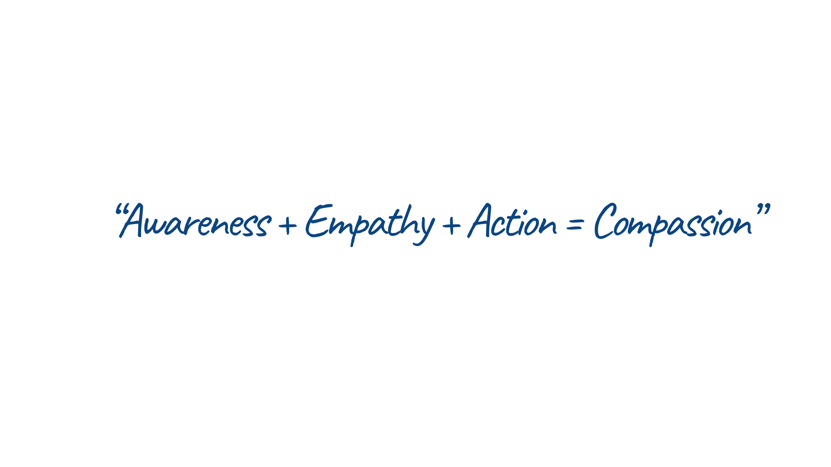
An equation for compassion
How is compassion encouraged at different levels of NHS
Scotland? What benefits does it bring?
Think about potential barriers to responding with compassion at different levels of NHS Scotland. Do you face any of these barriers in your own role? Are these also barriers to quality improvement?
How might these same potential benefits and barriers of compassion be relevant in response to the SDGs?
Notes:
Discuss with the group what they understand by compassion. Then use the discussion questions on the slide to think about the role compassion plays for both NHS Scotland and in achieving the SDGs.

Slide 13
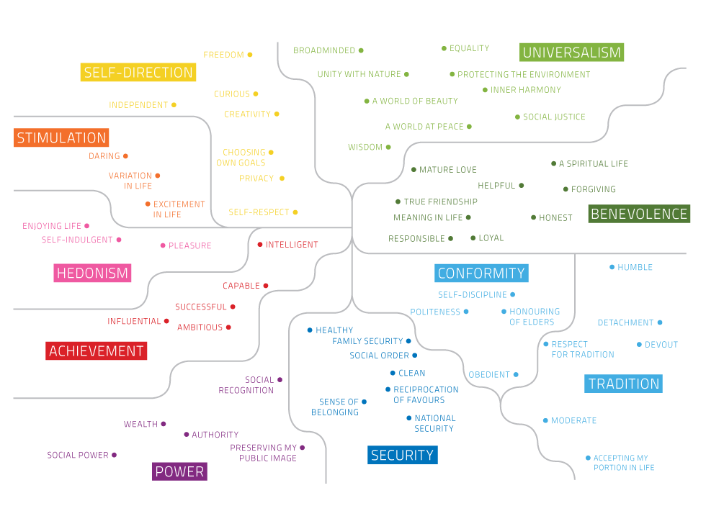
From the Common Cause
Notes:
Identify where the NHS Scotland values are on the diagram. Which areas are they clustered in?
· How does NHS Scotland strengthen these values?
· Can you think of a case where these values are weakened (perhaps unintentionally) due to other values on the opposite side of the diagram being strengthened?
What impact do you think this has?
· Think about which of these values is most important to you in your own role and discuss how this is activated in your own setting. How does this value align with or strengthen compassion?
For more information see https://valuesandframes.org/

Slide 14

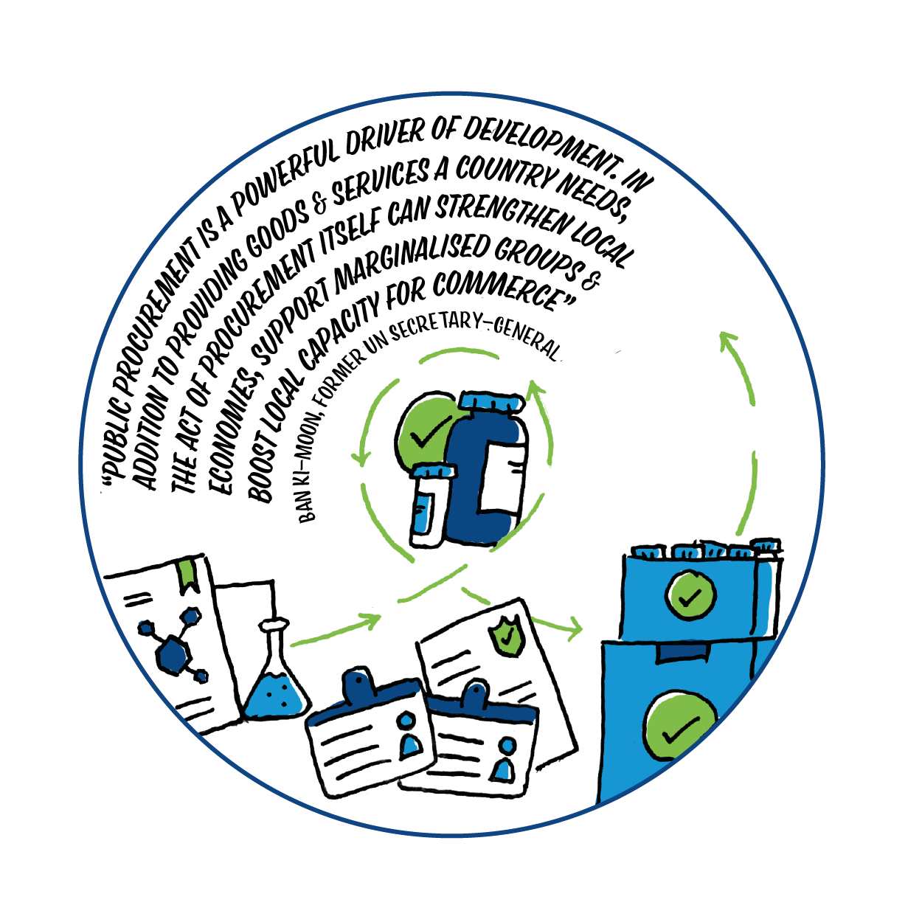
Final thoughts
What role do values play in creating change?
To what extent does compassion drive our actions to bring about change?
Notes:
These are some final reflection questions you might want to discuss as a group.

Slide 15
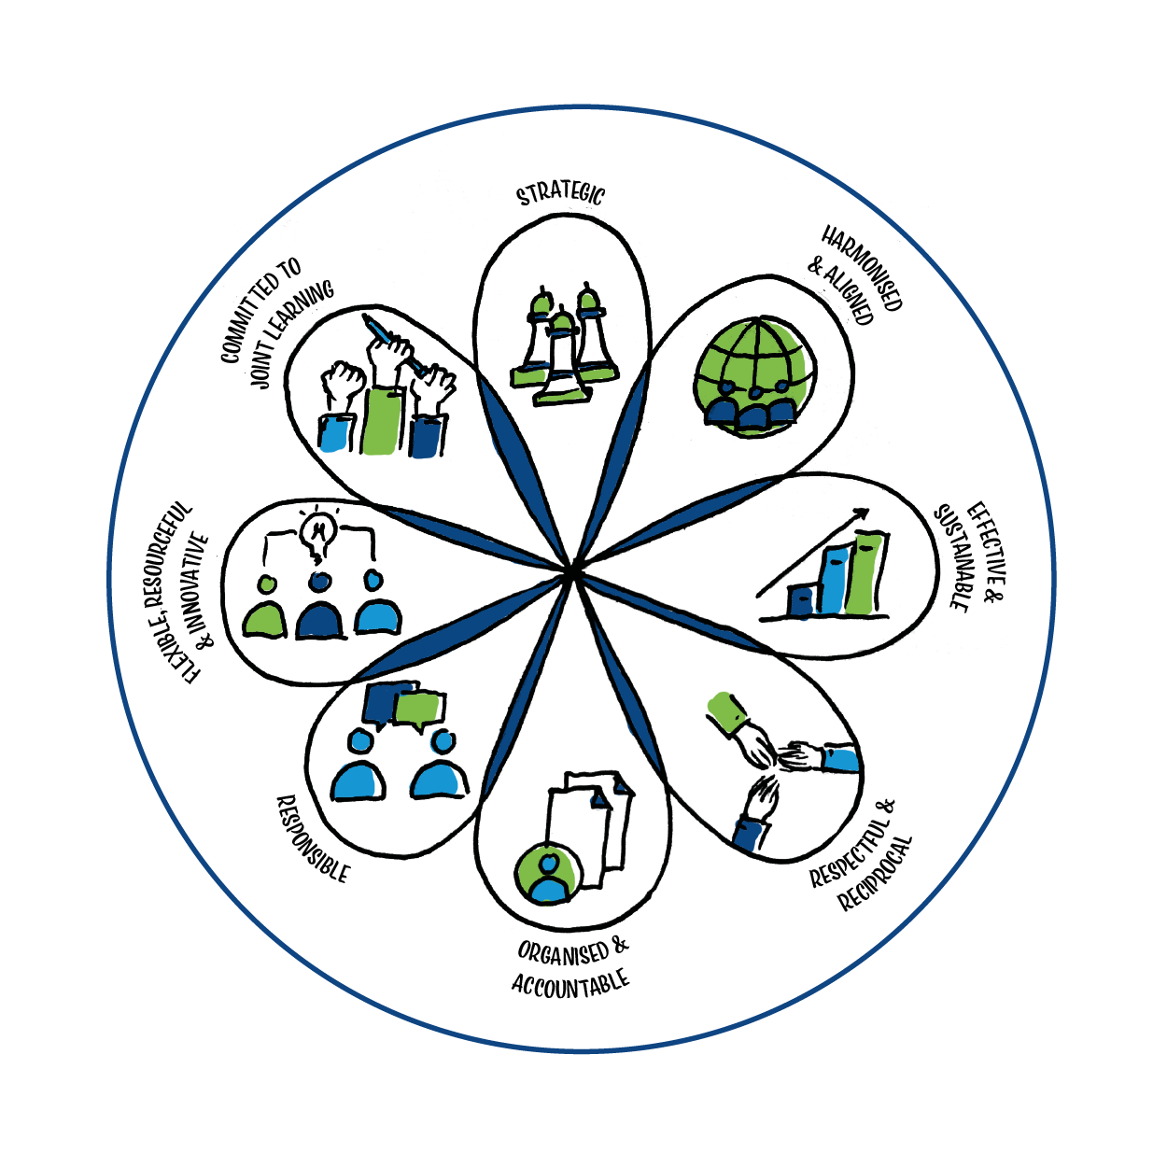
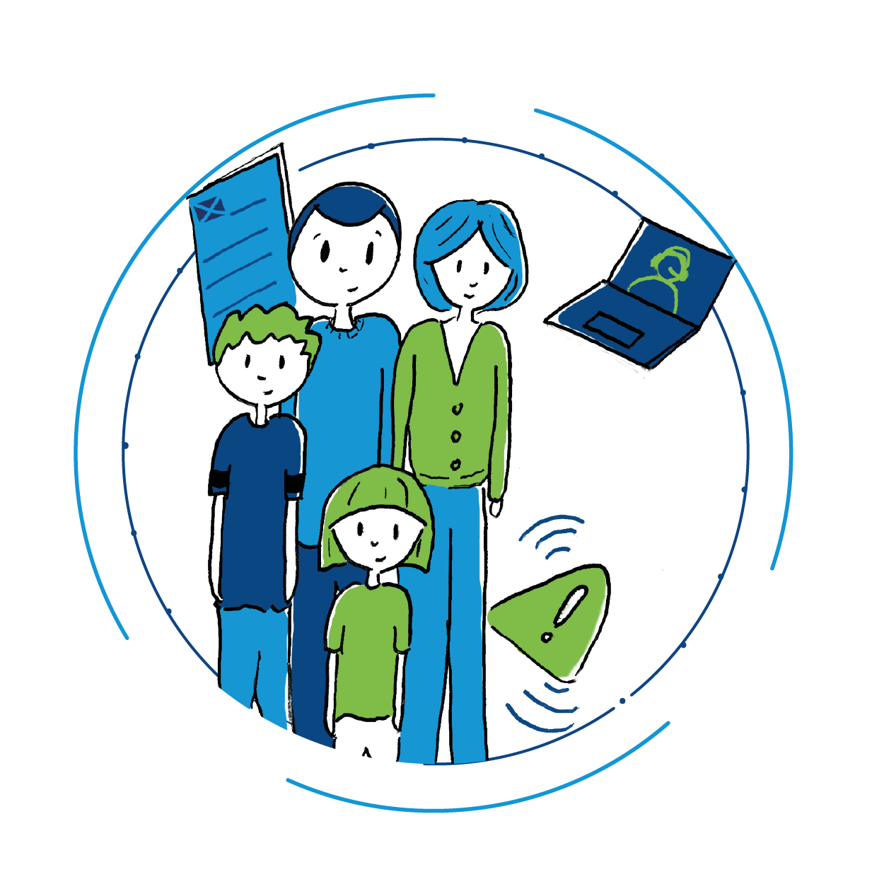
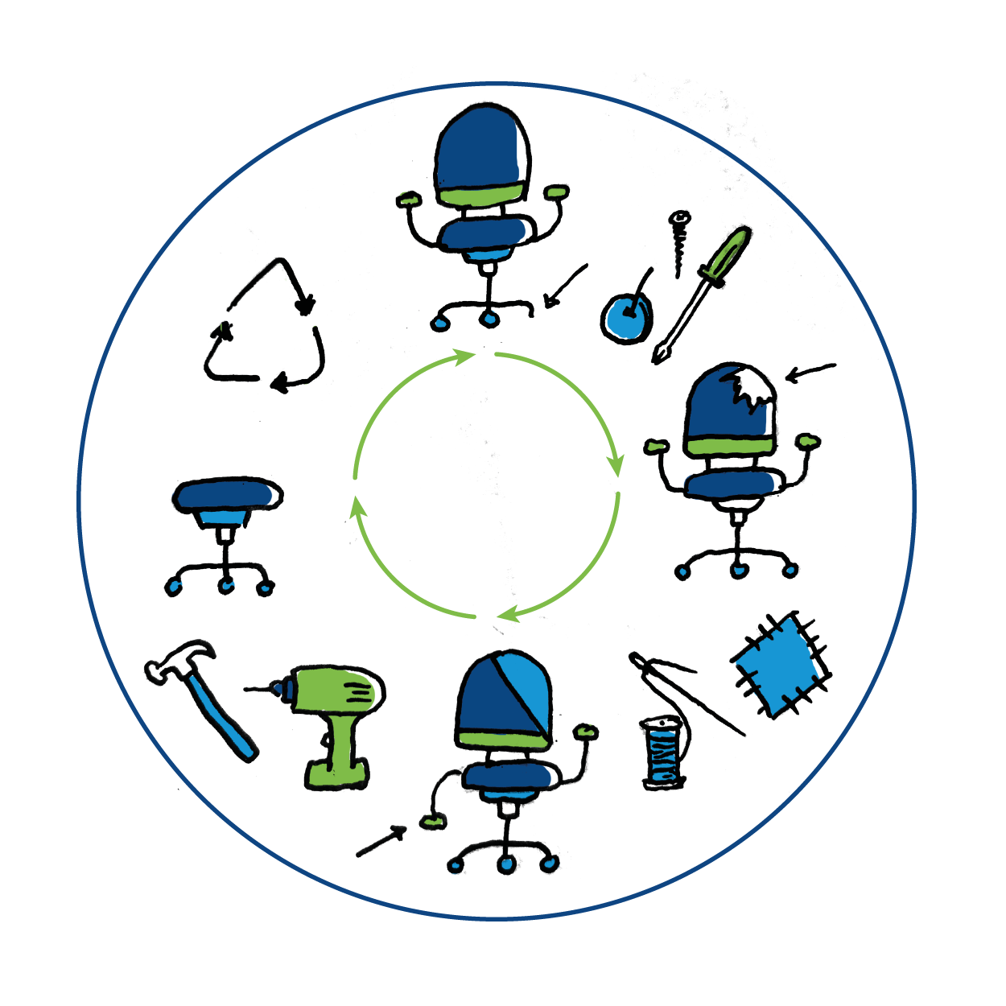
What next?
Going deeper with the SDGs
There are some themed sessions available on the following topics:
Poverty and inequality
Power and partnerships
Responsible consumption
Notes:
See PPTs and accompanying notes for exploring themed sessions.

Slide 16


Thank you for your time
www.scotdec.org.uk
www.scottishglobalhealth.org
@scotdeclearning
@scottishGHCU
The contents of this document are the sole responsibility of the 15 project partners and can in no way be taken to reflect the views of the European Union.

